Slide 1
FIT1047 Week 2 Forum
Introduction to Computer Systems, Networks and Security

Slide 2
Learning Outcomes
At the end of this workshop, you will be able to:
1. Work with Boolean algebra
2. Create simple digital circuits
3. Understand relation between Boolean logic and digital circuits
4. Use Boolean Laws and Karnaugh-maps to minimise Boolean functions

Slide 3
Forum Activity
Activity 1: Assignment 1 Briefing
Activity 2: Discussion and exercise on Boolean algebra and digital circuits
Activity 3: Discussion and practices on Boolean simplification

Slide 4
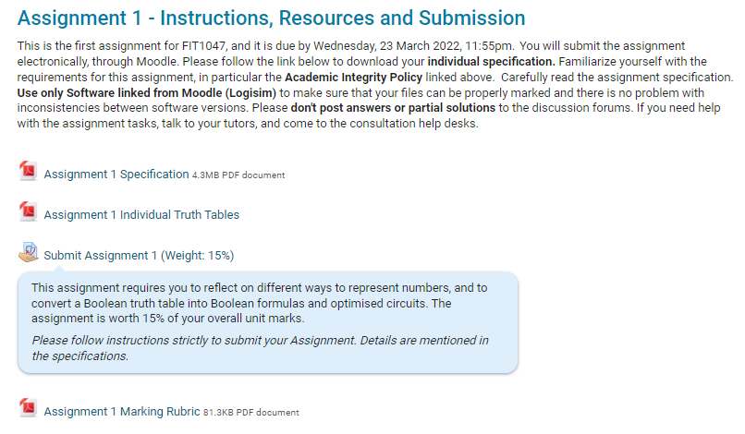
Activity 1: Assignment 1 Briefing

Slide 5
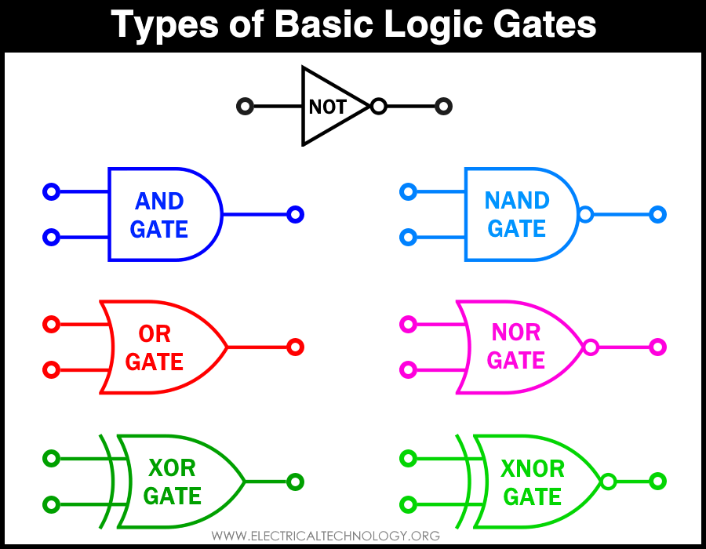
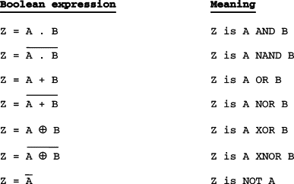
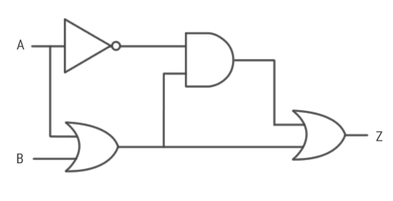
Activity 2: Discussion and exercise on Boolean algebra and digital circuits
There are 4 questions to be demonstrated how we convert a Boolean expression into digital circuits and vice-versa.
You need to formulate a Boolean function from a digital circuit or sketch a digital circuit from a Boolean function.

Slide 6
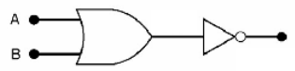
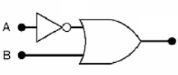
Activity 2: Logic Gate Circuit → Boolean Expression (Discussion)
Write the Boolean expressions for the following logic gate circuits

Slide 7
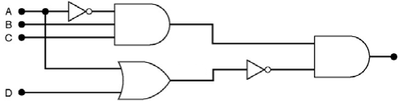
Activity 2: Logic Gate Circuit → Boolean Expression (Exercise)
Write the Boolean expression for the following logic gate circuit

Slide 8
Activity 2: Boolean Expression → Logic Gate Circuit (Discussion)
Sketch the logic gate circuit from the following Boolean expression.
F = (A+B)(B’+C)

Slide 9
Activity 2: Boolean Expression → Logic Gate Circuit (Exercise)
Sketch the logic gate circuit from the following Boolean expression.
F = AC+B’C+A’BC

Slide 10
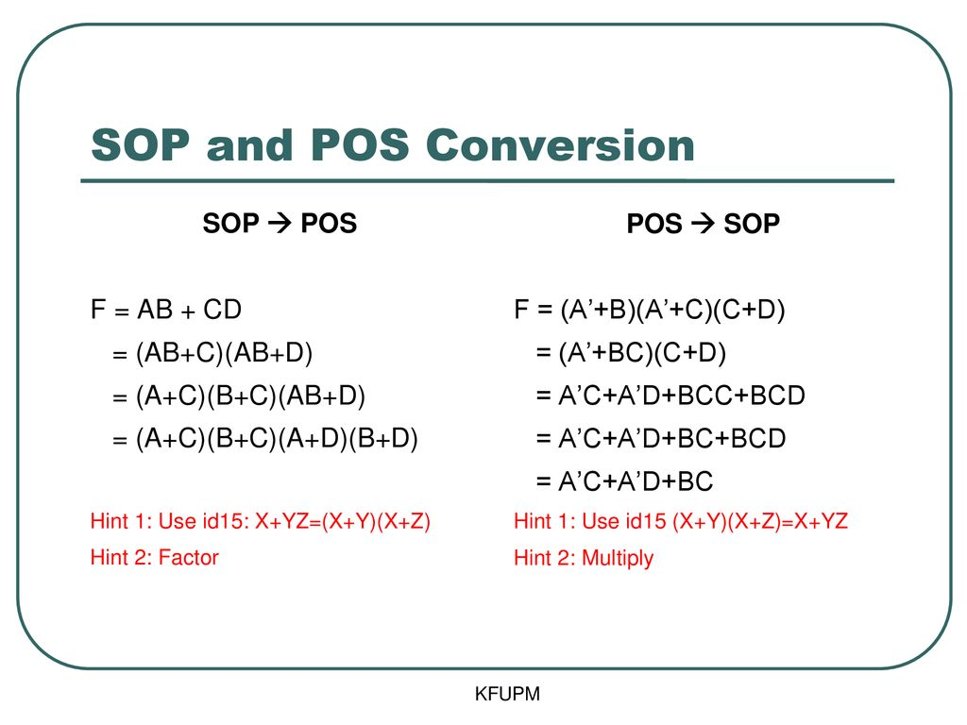
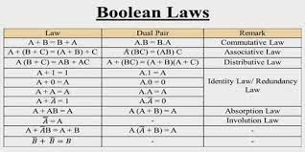
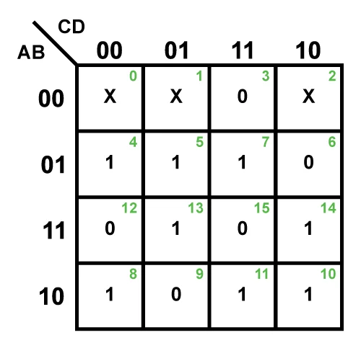
Activity 3: Discussion and Practices on Boolean Simplification
A discussion on the Boolean simplifications using Boolean’s Law and K-map.
Formulation of product of sum (POS) and sum of product (SOP).

Slide 11
Activity 3: Boolean Simplification using Boolean’s Law
Simplify F = AB + BC(B + C) and sketch the logic circuit before and after the simplification.

Slide 12
Activity 3: Boolean Simplification using Boolean’s Law
Show that the simplified form of F = A’B+BC’+BC+AB’C’ can be denoted as F = B+AC’

Slide 13
Activity 3: Boolean Simplification using K-Map
Construct the truth table for the Boolean expression of F = A’BC+AB’C+ABC’+ABC. Using K-Map, simplify the Boolean expression.

Slide 14
Activity 3: Boolean Simplification using K-Map

Slide 15
Activity 3: Boolean Simplification using K-Map

Slide 16
Activity 3: Boolean Simplification using K-Map (Self-Attempt)
Construct the truth table for the Boolean expression of F = A’B+BC’+BC+AB’C’. Using K-Map, simplify the Boolean expression.
Answers will be provided in the Moodle forum on Friday.

Slide 17
Boolean Simplification using K-Map
Write the Boolean expression from the truth table below. Using K-Map, simplify the Boolean expression.
A | B | C | F
0 | 0 | 0 | 1
0 | 0 | 1 | 0
0 | 1 | 0 | 1
0 | 1 | 1 | 1
1 | 0 | 0 | 0
1 | 0 | 1 | 1
1 | 1 | 0 | 1
1 | 1 | 1 | 1

Slide 18
Activity 3: Boolean Simplification using K-Map (Self-Attempt)
Write the Boolean expression from the truth table below. Using K-Map, simplify the Boolean expression.
A | B | C | F
0 | 0 | 0 | 1
0 | 0 | 1 | 0
0 | 1 | 0 | 1
0 | 1 | 1 | 0
1 | 0 | 0 | 1
1 | 0 | 1 | 0
1 | 1 | 0 | 1
1 | 1 | 1 | 0
Answers will be provided in the Moodle forum on Friday.

Slide 19
Activity 3: Sum of Product (SOP) and Product of Sum (POS)
Formulate a Boolean expression from the truth table in SOP form and POS form.
A | B | C | F
0 | 0 | 0 | 0
0 | 0 | 1 | 0
0 | 1 | 0 | 1
0 | 1 | 1 | 1
1 | 0 | 0 | 1
1 | 0 | 1 | 1
1 | 1 | 0 | 1
1 | 1 | 1 | 0

Slide 20


